Slide 1
Smart shoes
Gait disease prognosis and fall prevention/detection
Team SAL
Member: Shobhit Aryan Lal
Discord id: aryan_shobhit#0528

Slide 2
Problem Statement
-> Gaits is one of the most common disease in elderly people. Identification of gaits in early stage is bit difficult as:
> it requires camera setup to monitor the person’s walking style,
> capturing each movement points
> even more difficult when silhouette image is not much clear ( because of long coat or a bag/purse).
-> Falls are the one of the most common cause for accidental deaths in elderly people.

Slide 3
Statistics
Gaits
The prevalence of gait and balance disorders markedly increases with age, from around 10 % between the ages of 60 and 69 years to more than 60 % in those over 80 years
balance and gait problems may be precursors of falls
gait disorders and falls are largely underdiagnosed and often receive inadequate evaluation
Falls
Falls are the second leading cause of accidental or unintentional injury deaths worldwide.
Each year an estimated 646 000 individuals die from falls globally of which over 80% are in low- and middle-income countries.
Adults older than 65 years of age suffer the greatest number of fatal falls.
37.3 million falls that are severe enough to require medical attention occur each year.

Slide 4
Proposed Solution
> A footwear with set of sensors ( pedometer, accelerometer, gyroscope, gsm chips) attached to it to measure various parameters like pressure, velocity, stride length etc. These parameters will be analysed by efficient algorithms to predict likelihood of gait disease.
> The data collected will help to monitor the degree of the disease, whether the medications are helping to improve it or not.
> For fall prevention, infrared sensors in the front part of footwear will help to detect any obstacle and will alarm the wearer.
> Fall detection system will be installed to notify the care giver of the elderly person in real time.

Slide 5
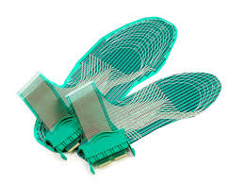
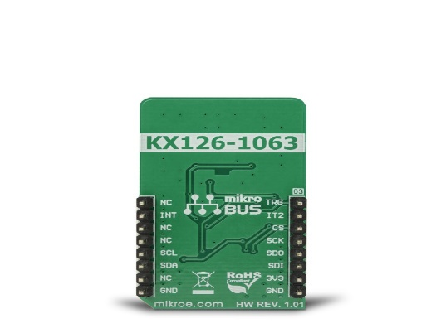
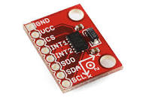
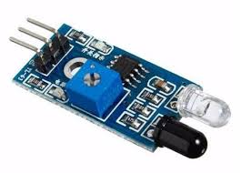
Sensors Used
-> F-scan in-shoe sensor will capture timing and pressure information for foot.
-> Pedometer sensor will help to detect the motion of a person.
-> Accelerometer sensor will help in measuring the acceleration of the body.
-> Infrared sensor will help to detect the obstacle present in front of foot.

Slide 6
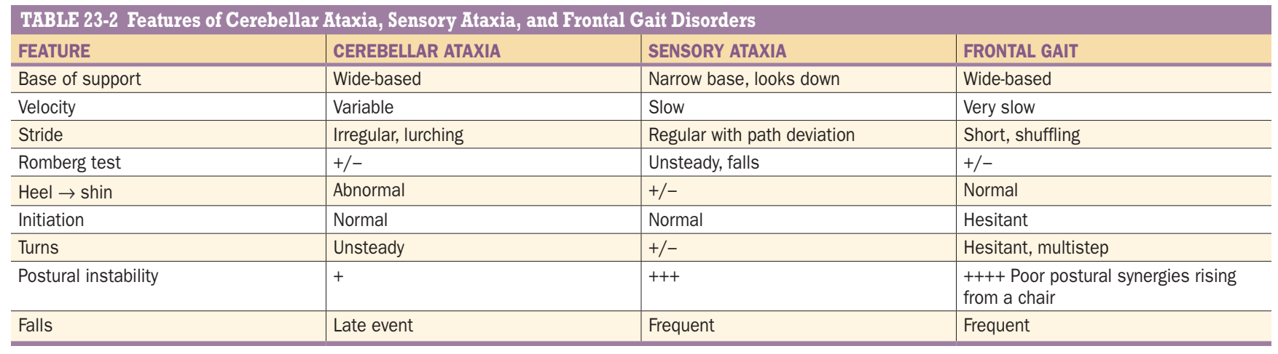
Parameters for gaits analysis

Slide 7
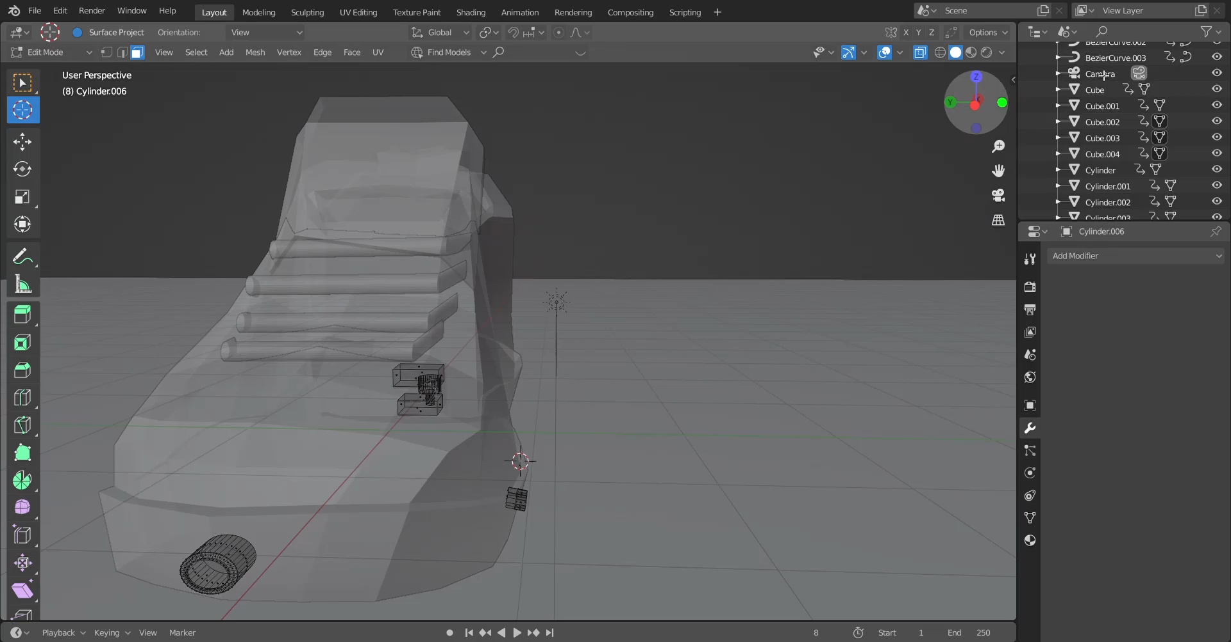
3D Model of shoe

Slide 8
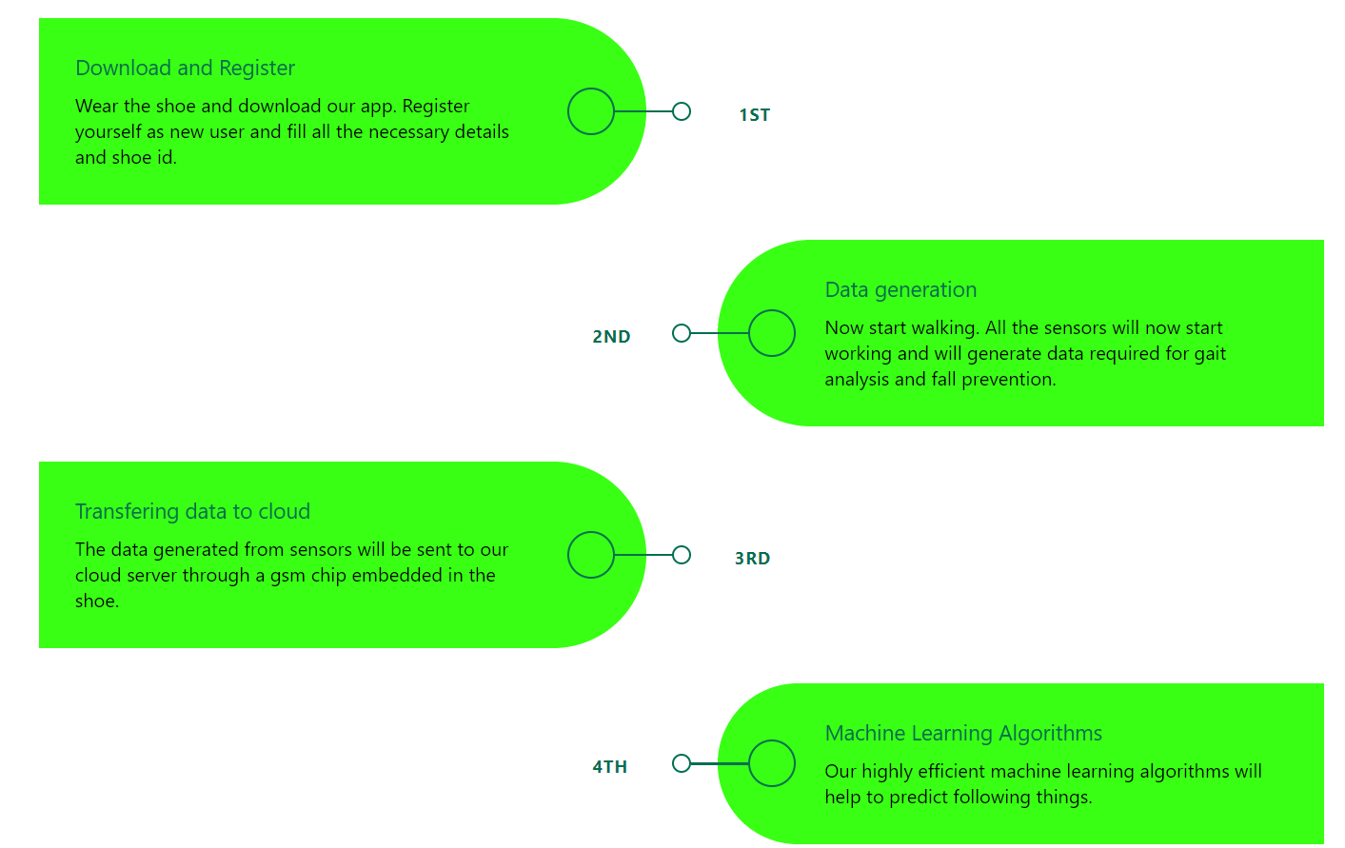
Flowchart of solution

Slide 9
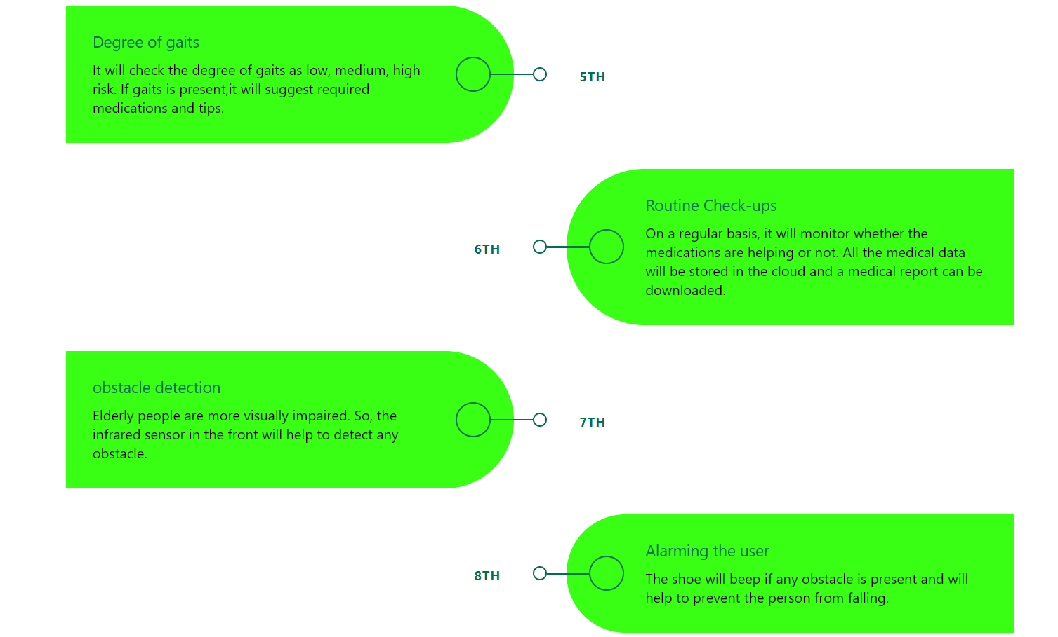

Slide 10
